Slide 1
DMU380 SW Review
For 7/01/13

Slide 2
Agenda
SW block diagram
Synchronous sampling
How each sensor gets sampled
Data acquisition timeline
Latency
OS tasks
Code organization
Data acquisition
Debug interface
UCB interface
Packets
Demo!
SPI interface
System configuration

Slide 3
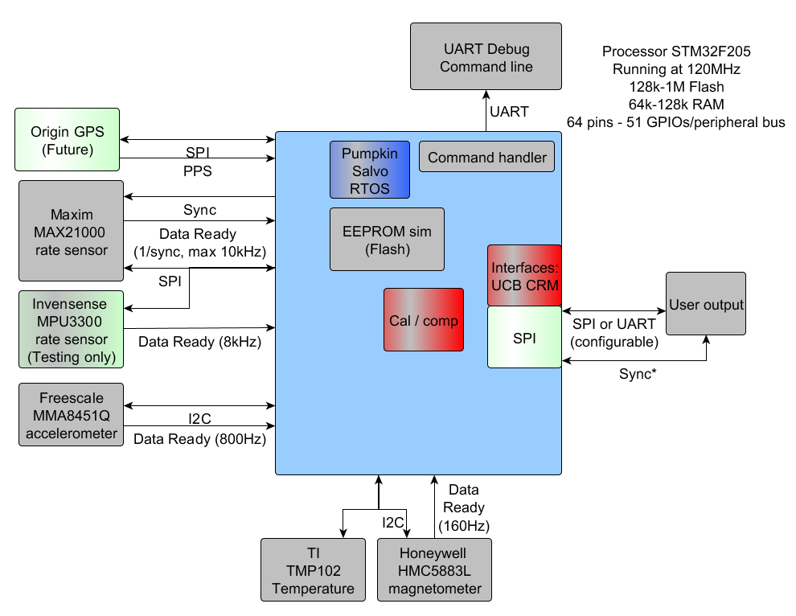
SW block diagram

Slide 4
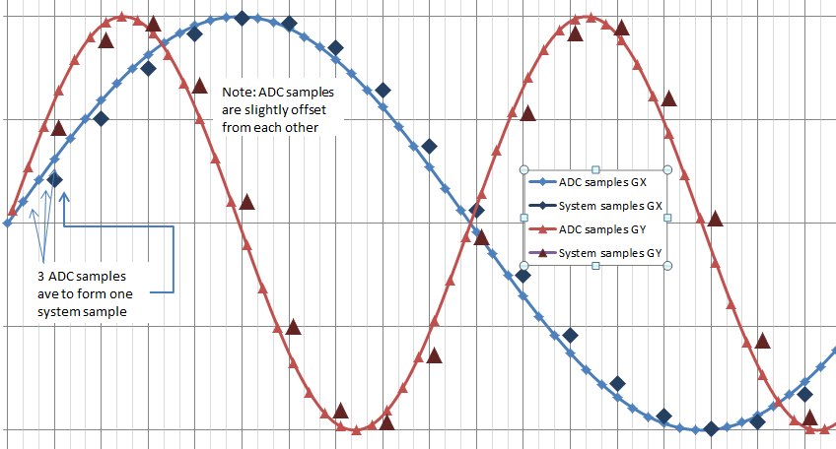
Sampling methods: 440
Analog sensors connected to an ADC. ADC gets data as fast as it can, accumulating the data. When a sample is needed, the accumulated data is divided by number of samples (averaged). Each sample to the system represents N samples from the ADC.

Slide 5
Sampling the MAX21000
Processor controls sample start of rate sensor.
Timer interrupt (TIM5)
Assert rate sensor sync line
Rate sensor does conversion
Data ready interrupt
Read data (SPI, DMA)
OS signal RATE_READY
Task data acquisition
Internally, the MAX21000 is sampling at 10kHz. It is very likely they do something similar to the 440; when sensor receives sync, it starts averaging over the 10kHz samples until it gets enough to have a 400Hz data rate.

Slide 6
Sampling the MMA8451Q
There is no sync line on the accelerometer, it can output at 800Hz (or 400Hz) but it asynchronous to the rate sensor sampling.
The accel data gets accumulated (in an interrupt) and when the system is ready to proceed, the data is averaged to a system sample.
Note that if the system is running 400Hz, there may be 1-3 800Hz accel samples averaged to make the system sample.
Timer interrupt (TIM5)
Clear accumulation buffer
Wait for RATE_READY & ACCEL_READY
Task data acquisition
Average accumulation buffer
Data ready interrupt
800Hz
Read data (I2C)
Accumulate date
OS signal ACCEL_READY

Slide 7
Sampling the MPU3300
X
The Invensense rate sensor also does not have a sync line. The process is very similar to the accelerometer but the data is at 8kHz instead of 800Hz so more sensor samples are accumulated between system samples.
Note: if this gyro is the target, the timer interrupt needs to signal the accel and gyro to be finished.

Slide 8
Sampling the HMC5883L
Benignly asynchronous, max output is 160Hz. Data is picked up as it is available; previous sample is used until new is available.
Timer interrupt (TIM5)
If mag was finished, start new sample
Data ready interrupt
Read data (I2C)
OS signal MAG_READY
Task data acquisition
Temperature sensor is the essentially same but it is at 1Hz so it gets updated very rarely.

Slide 9
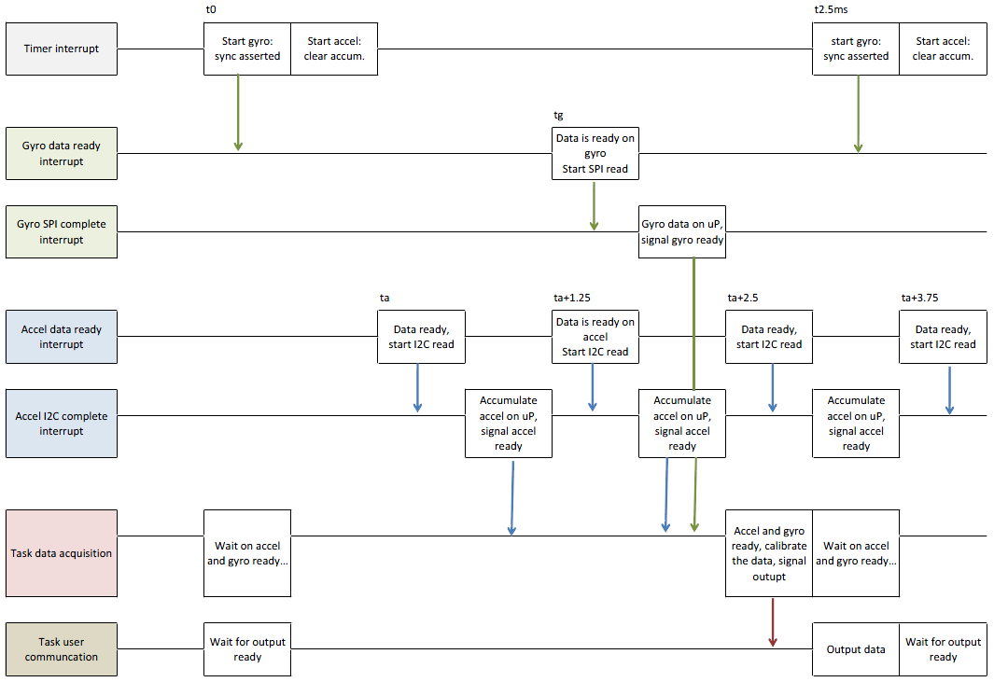
Data Acquisition Timeline

Slide 10
Tasks
Task | Run at | Priority | Notes
Get data from sensors, apply calibration | 400Hz | 1
Process user (and debug) commands | (when rx interrupt occurs) | 2
Calculate cal data (temperature data) | 1Hz | 3 | (Not implemented.) ??
Calculate angles (nav) | 200Hz | 4 | (Not implemented.)
Position, velocity, Kalman error calculation | 100Hz | 5 | (Not implemented.)
GPS processing, correction calculation | 1-10Hz | 7 | (Not implemented.)
Heartbeat | ~7Hz | 14 | Toggles GPIO.
World magnetic model | Any free time | 15 | Update every 10 min (Not implemented.)
OS idle | Any leftover time | 16

Slide 11
Code organization: Data
Data Acquisition
Timer Interrupt
Rate
Temp
Mag
I2C
Accel
Data ready
Data ready
SPI
Data ready
Calibration and compensation
EEPROM in Flash

Slide 12
Code organization: Debug Interface
Details:
- 921600, 8, N, 1, no flow control. (Sometimes different baud, depends on what’s needed.)
- Used to test each part of the system during bring up. Each sensor can be polled (individually), configured, re-initialized. (Test driven development.)
- This is the developer’s interface, used before SPI and standard UART are ready.
TaskCommandLine
Command handler (table)
Debug USART
g
gf
a
af
Accel
Rate
…
…
…

Slide 13
Code organization: XBOW Interface
TaskUserCommunication
ProcessUcbCommands
ProcessCrmPort
ProcessContUcbPkt
ProcessDiagOutput
… A LOT OF CODE …
User UART
Emulating 440/525 interface
Works with Nav-View
Uses configurator to program on-board flash*

Slide 14
Current packet status: UCB
Working | Untested | Future
Ping, echo, get packet, NAK | Program, software, algorithm reset | AngleU, Angle0, Angle1, Angle2, Angle4 (which?)
Get, set, read, write fields | Write cal | Scaled2
Read, write, unlock EEPROM | Test0, Test1 | Mag cal1, 3
ID, version, version all data
Scaled1, Factory1, Factory2

Slide 15
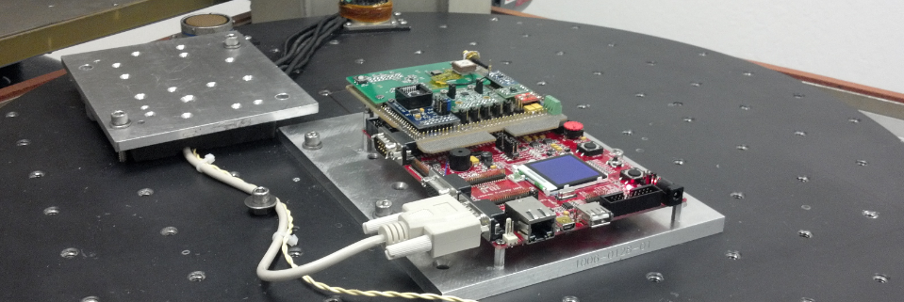
Demo!
Use Nav-View and see sensors outputting packets. The system already (kind of) works. And did you see all the wires? There are a lot of wires (also you should see Ed’s board because it is much prettier.)

Slide 16
Code organization: SPI Interface
TaskUserCommunication
Register based Interface
SPI
There is still a lot to be done here: interface definition is about 30% complete. Then the code needs to be written. SPI driver should be straightforward (there is already SPI driver in the code).

Slide 17
System configuration
Output data rate: 400Hz
SPI or serial (i.e. RS232) options
Accelerometer options: 2G, 4G, 8G
Rate options: 250dps or 400dps
Mag options: big range from 0.88Ga to 8Ga
All of these are factory configurable. The output data rate may be user configurable.

Slide 18
Things still to do
SPI interface (new) and other side of comms
Review 440 configurator, intended configuration
Improve error handling (I2C and SPI timeouts)
Finish calibration support (misalign and orient): everything is in place but this is untested
Test firmware update
Board bring up of new board: mostly minor differences
Documentation
Future
Algorithm for angles, nag
Add GPS
Q math is all floats (may not need to fix)

